Slide 1
Randomized Algorithms CS648
Lecture 25
Summary of the course

Slide 2
Mini Projects

Slide 3
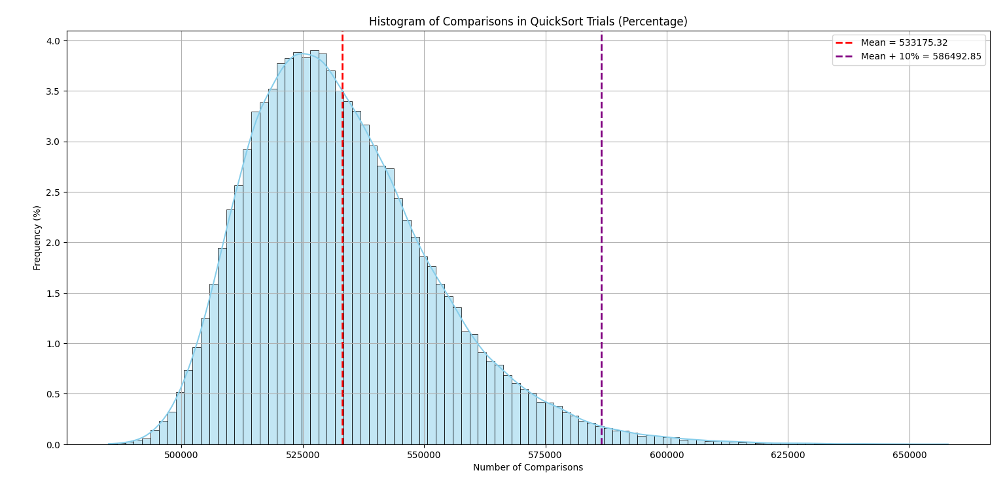
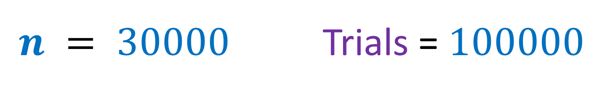


$n = 30000$ Trials = $100000$
Quick Sort
mean
mean + $10$%
$$<0.25\%$$

Slide 4










$n :$ number of bits
Primality Testing
Deterministic algorithms:
Trivial:
AKS [2002]:
Randomized algorithm:
Miller Rabin[1980]
Error Probability
$$O(2^{\frac{n}{2}})$$
$$O(n^{6})$$
$$O(n^{2}\log{n})$$
$$<n^{−c}$$
No. of Digits | Trivial Deterministic | Randomized
$$20$$
$5127$ ms
$0.187$ ms
$$1000$$
$18.5$ ms

Slide 5
Summary of the journey

Slide 6
Probability Tools
Random Variable and Expected value
Linearity of Expectation
Partition Theorem
Union theorem

Slide 7
Probability Tools
Bounding the probability of deviation
Markov Inequality
Chernoff Bound
Method of Bounded Difference (MOBD)

Slide 8
Memorable Problems
Approximate Median
Quick sort
Expected number of comparison
Concentration of its running time
Finger printing and Freivald’s technique
Bounding the duration of a random experiment
Coupon Collector Problem
Random walk on line
Client server problem
O(log log n) rounds

Slide 9
Memorable Problems
Power of random sampling
Approximate Median
Approximating the size of transitive closure
BPWM problem
Hashing
Perfect hashing
Hashing with optimal size and worst case O(1) query time
Routing on a hypercube
Bit fixing protocol
Last worked out problem

Slide 10
Memorable Problems
Approximate Distance Oracles
Minimum cut in multi-graph
Randomized Incremental Construction
Closest Pair of points
Convex hull
Smallest enclosing circle

Slide 11
Memorable Problems
Delay Sequences
Approach each problem with
a fresh and unconditioned mind

